Slide 1


Cohort Analysis of Ironhack Payments Users
Ironhack Data Science and Machine Learning Bootcamp
Author: Ginosca Alejandro Dávila
Date: December 13, 2024
Project 1
LOGO HERE
Notes:
Hello everyone, and thank you for being here.
This presentation is part of my first project for the Ironhack Data Science and Machine Learning Bootcamp, and it focuses on a Cohort Analysis of Ironhack Payments Users.
My name is Ginosca Alejandro Dávila, and I’m excited to walk you through the insights and learnings I’ve uncovered during this analysis. Let’s begin.

Slide 2
Project Overview
Project: Cohort Analysis of Ironhack Payments Users
Goal: Understand user behavior over time, segmented by their first cash request month
About Ironhack Payments: Ironhack Payments is a digital financial services company offering short-term cash advances with transparent pricing. Users can:
Request regular (free) or instant (fee-based) transfers
Repay via scheduled SEPA direct debits
Encounter fees for instant transfers, postponements, or failed payments
Notes:
This project centers on a cohort analysis of Ironhack Payments users. The main objective is to understand how user behavior evolves over time, segmented by the month of their first cash advance request.
Ironhack Payments is a digital financial services platform that offers short-term cash advances. Their business model emphasizes transparent pricing without traditional interest — instead, users may pay fees for certain services.
Users have a few key interactions with the platform:
They can request regular (free) or instant (fee-based) transfers.
Repayments are made via scheduled SEPA direct debits.
And they may encounter fees if they request instant transfers, postpone repayment dates, or if a payment incident occurs.
Understanding these user flows helps guide the metrics we analyze and provides context for behavioral trends.

Slide 3
Key Metrics Analyzed
📈 Frequency of Service Usage
⚠️ Incident Rate
💰 Revenue Generated
🧠 New Relevant Metric
Measure how often users from each cohort use Ironhack Payments’ cash advance services over time.
Track the rate of payment incidents (e.g. failed reimbursements) by cohort to identify trends or risk patterns.
Calculate the total fees collected per cohort to assess the financial contribution of each user group.
Includes an additional user behavior or performance metric tailored to reveal deeper insights beyond standard KPIs.
Notes:
In this project, we’re focusing on four key metrics to evaluate user behavior and cohort performance.
The first is Frequency of Service Usage — we measure how often users from each cohort request cash advances over time. This helps us understand engagement and usage longevity.
Next, we calculate the Incident Rate, which tracks failed reimbursements or other payment issues by cohort. This reveals patterns of risk and highlights areas for operational improvement.
The third metric is Revenue Generated. We sum the total amount of fees paid by each cohort to understand their financial contribution to the business.
Lastly, we include a Custom Metric. This will be a tailored indicator that goes beyond standard KPIs — it could focus on behavioral patterns, retention trends, or a unique insight that emerges from the data.
Together, these metrics provide a well-rounded view of user lifecycle, risk, and value.

Slide 4
Dataset Summary
🧾 Data Source
📄 Cash Requests (cash_df):
💸 Fees Dataset (fees_df)
23,970 rows × 16 columns
Contains one row per cash advance request
Includes: cash request ID, amount,status, timestamps, user IDs, transfer type, reimbursement info, recovery info
21,061 rows × 13 columns
Contains one row per fee applied to a cash request
Includes: ,fee ID, cash request ID, fee type, status, reason, category, timestamps, amount and charge timing
Provided by Ironhacks Payments as raw .csv and .xlsx files
Definitions and business context available in Lexique - Data Analyst.xlsx
Notes:
Our project is based on two primary datasets provided by Ironhack Payments in CSV format, along with a Lexique file that explains the business context and column definitions.
On the left, we have the cash_df dataset, which contains nearly 24,000 rows — one per cash advance request. Each row includes the request ID, amount, status, creation and update timestamps, user identifiers, transfer type, reimbursement information, and recovery status in case of payment incidents.
On the right, we have the fees_df dataset, with just over 21,000 rows. Each row corresponds to a specific fee applied to a cash request. This includes fee ID, type, status, reason, category, and when the fee was charged.
Understanding the structure of these datasets is key for both our data cleaning process and the subsequent cohort analysis.

Slide 5
Data Quality Assessment
✅ Checked for missing values
Mostly expected (e.g. reimbursement_date missing for requests that were rejected, canceled, or already reimbursed)
Some required deeper inspection (e.g., user_id, cash_request_id)
✅ Verified datetime columns
Inconsistent formats and some timezone-aware vs. naive values
No future-dated timestamps found beyond 2024-12-12
✅ Validated monetary fields
No negative or zero values in amount or total_amount
✅ Checked link integrity between datasets
Found 4 fees_df rows with missing cash_request_id
✅ Duplicate analysis
No fully duplicated rows or duplicate primary keys found
Notes:
In this phase, I focused on understanding the reliability of the raw data before applying any cleaning steps.
I started by reviewing missing values. Most of them were expected — for example, the reimbursement_date is often missing for requests that were either canceled, rejected, or already reimbursed. Others like user_id and cash_request_id required deeper inspection to ensure they wouldn’t break links or logic downstream.
I also validated all datetime fields, where I found a mix of timezone-aware and naive formats. After normalizing them, I verified that there were no timestamps mistakenly placed in the future.
For monetary fields, I confirmed that all values in amount and total_amount were valid — no negatives or zeroes.
I checked for dataset link integrity and found just four rows in the fees dataset missing a cash_request_id. These couldn’t be linked to any cash request and were flagged for removal.
Finally, I performed a duplicate check, and I’m happy to report there were no fully duplicated rows or primary key conflicts.
This assessment gave me a clear understanding of the key quality issues to address in the next step: data cleaning.

Slide 6
Data Cleaning Summary
✅ Converted all date columns to be timezone-naive (datetime64[ns])
✅ Stripped inconsistent timezones for uniformity
✅ Unified user_id and deleted_account_id into final_user_id
✅ Removed 4 unlinkable rows from fees_df
✅ Standardized categorical values (e.g., status, type)
✅ Verified and preserved monetary columns (amount, total_amount)
✅ Reordered columns for analysis readability
Notes:
Based on the quality checks, I applied several cleaning steps. All datetime fields were converted and normalized for consistent use. I created a unified final_user_id to ensure we could group users accurately, regardless of account deletion.
I also removed rows that couldn’t be linked across datasets, and standardized categorical values to prevent mismatches during grouping. Finally, I verified the numeric columns and reordered variables to improve dataset usability going forward.

Slide 7
Exploratory Data Analysis Overview
🔎 EDA Objectives
📁 Cleaned Datasets Used
Understand request volumes, fee types, and user behavior
Uncover time-based trends in requests, revenue, and incidents
Prepare data for cohort definition and metric aggregation
clean_cash_requests.csv: 23,970 rows
clean_fees.csv: 21,057 rows
Notes:
Before jumping into cohort analysis, I conducted exploratory data analysis to better understand the structure and behavior of the cleaned datasets. This helped me surface trends in usage, revenue, and platform risks. The data used here was the output of the previous cleaning phase.

Slide 8
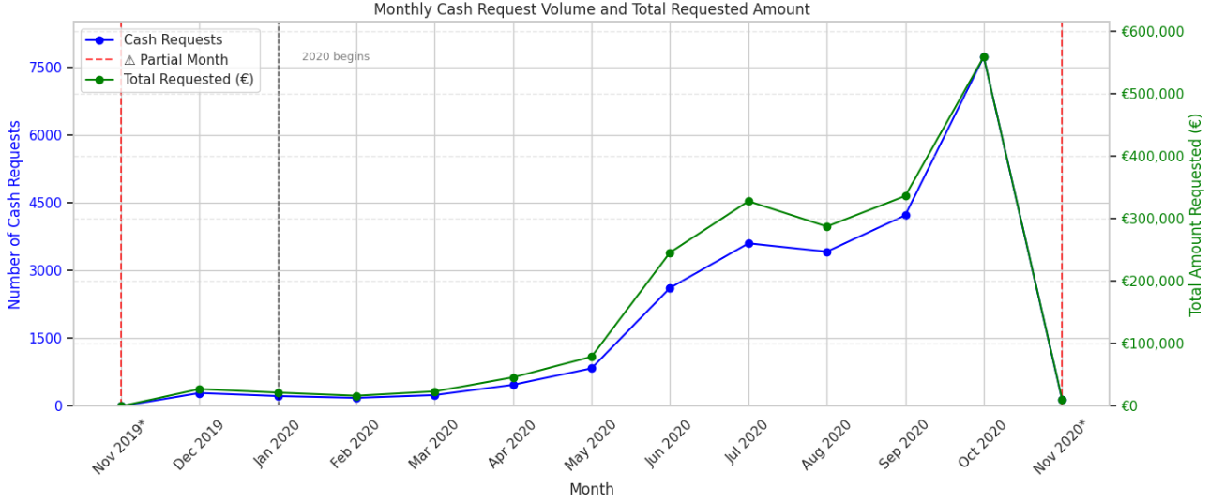
Request and Revenue Growth Over Time
📈 Key Insights
Strong growth began in May 2020, accelerating through the summer
October 2020 marks the peak in both requests and cash volume
Request volume and requested amounts mirror each other closely
📆 Note: Nov 2019 and Nov 2020 are partial months
Notes:
We can clearly see a strong upward trend starting in May 2020, with both the number of requests and the total cash amounts rising steadily each month. The chart shows how closely these two trends mirror each other — when more users requested cash, they also requested higher total amounts.
The platform reached its peak in October 2020, both in terms of user activity and financial demand. It’s important to note that the first and last months shown — November 2019 and November 2020 — are partial months, which explains their lower numbers.
These patterns give us a solid foundation to define user cohorts by month and better understand behavior over time.

Slide 9
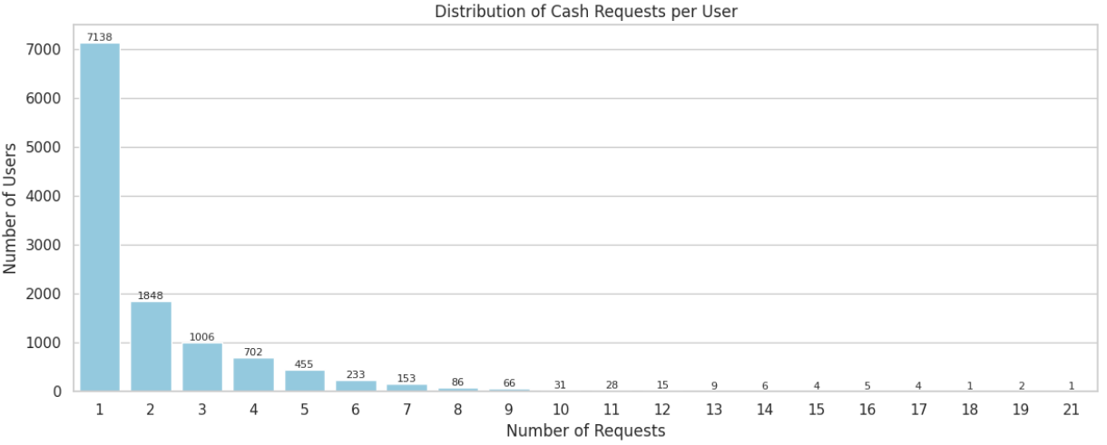
User Activity and Behavior
👤 User Insights
11,793 total unique users
60.5% used the service only once
Remaining 39.5% used it multiple times
Notes:
Most users are one-time users, but nearly 40% returned for additional cash requests. This distribution shows there's a meaningful segment of repeat users, which could impact cohort retention and revenue metrics

Slide 10
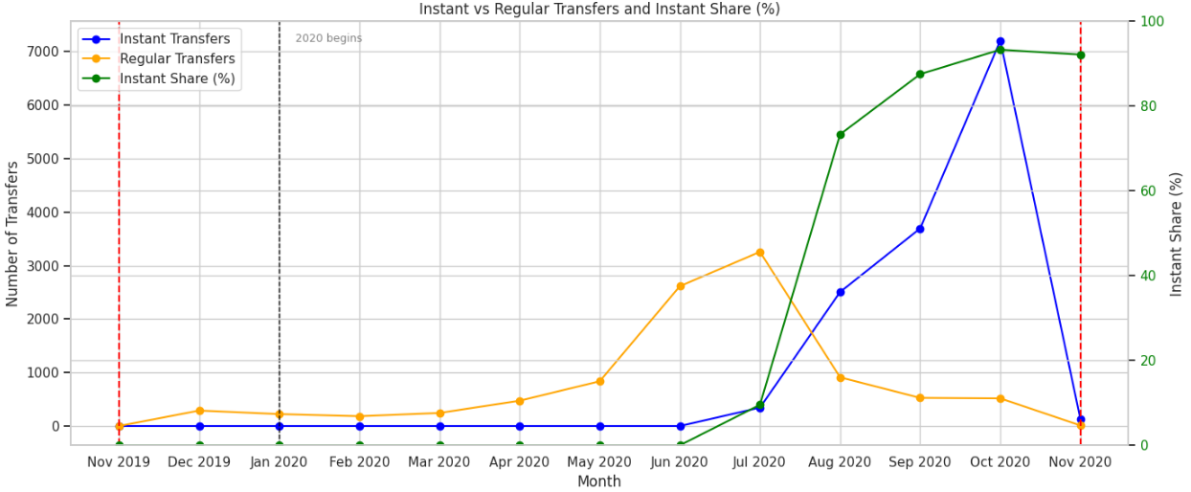
Transfer Preferences Over Time
🚀 Instant vs Regular Transfers
Instant transfers introduced around July 2020
Instant share increased to 93% by October 2020
Regular transfers declined as instant became dominant
Notes:
This shift shows a clear preference for faster service, despite the fee. Instant transfer usage rose from 0% to over 90% in just a few months, influencing both revenue and operational patterns.

Slide 11
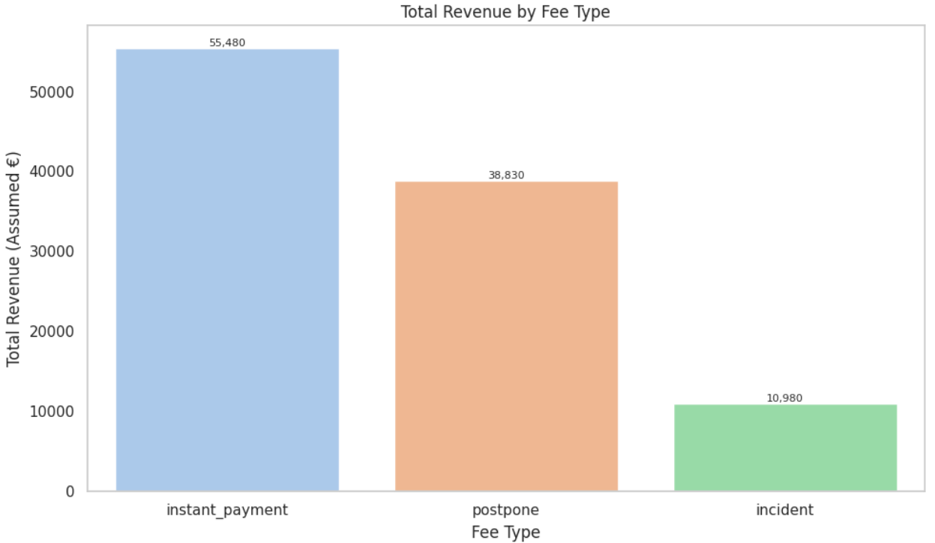
Revenue Breakdown by Fee Type
💸 Revenue Sources
Instant fees: €55,480
Postpone fees: €38,830
Incident fees: €10,980
Notes:
Instant fees are the largest source of revenue, followed by postpone and incident fees. This confirms that the fee model works primarily through user preference for instant service, rather than penalties or late payments.

Slide 12
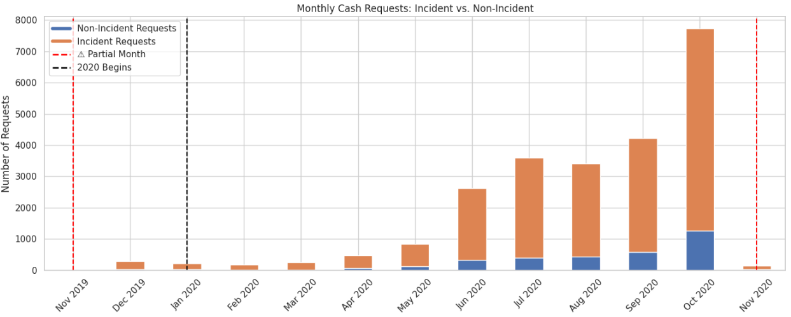
Incidents and Risk Trends
⚠️Incident Insights
86% of requests had no incidents
Peak incident volume in October 2020
Incident rate remained stable around 10–16%
Notes:
While most requests are completed without issue, the number of incidents grew in line with user activity. Still, the incident ratio stayed relatively stable, suggesting a manageable risk profile despite growth.

Slide 13
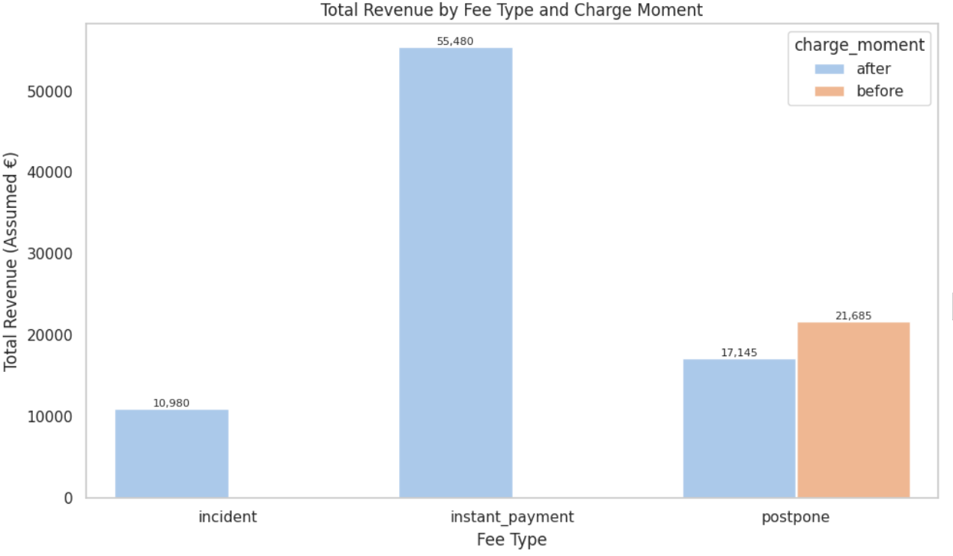
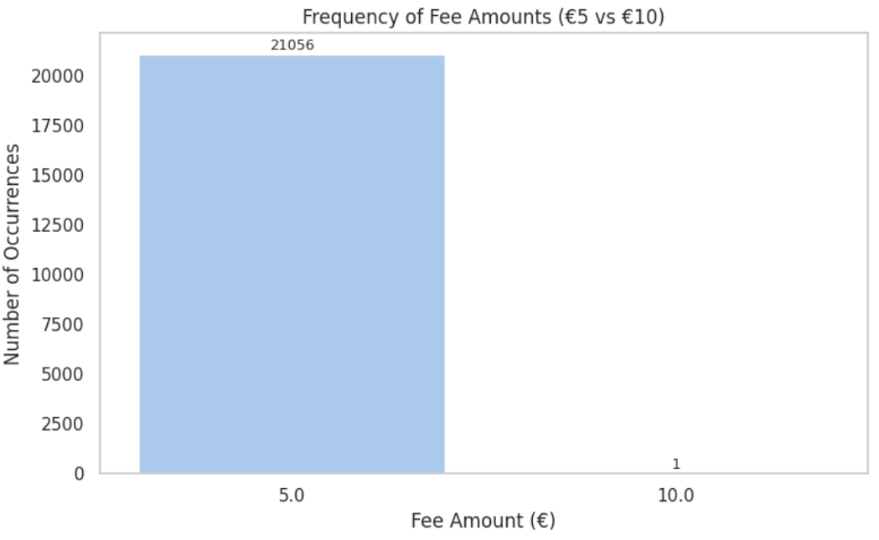
Revenue Timing and Fee Consistency
📈 Key Insights
Instant and incident fees are always charged after request
Postpone fees can be charged before or after
99.99% of fees are flat €5 (only one €10 outlier)
Notes:
Here we see how the timing of fees relates to user behavior — incident and instant fees are charged after the request, while postpone fees are more flexible. It’s also worth noting that nearly all fees are set to a flat €5, showing a simple, predictable pricing structure, which could positively influence user trust.

Slide 14
Linking Requests to Revenue
🔗 Merged Dataset Overview
Merged on cash_request_id
23,970 cash requests, 12,933 had fees (~54%)
Resulting dataset: 32,094 rows x 33 columns
Notes:
By merging the datasets, I was able to trace which requests triggered which fees. This linkage is crucial for analyzing user behavior and financial impact at the request level, enabling better cohort-based analysis going forward.

Slide 15
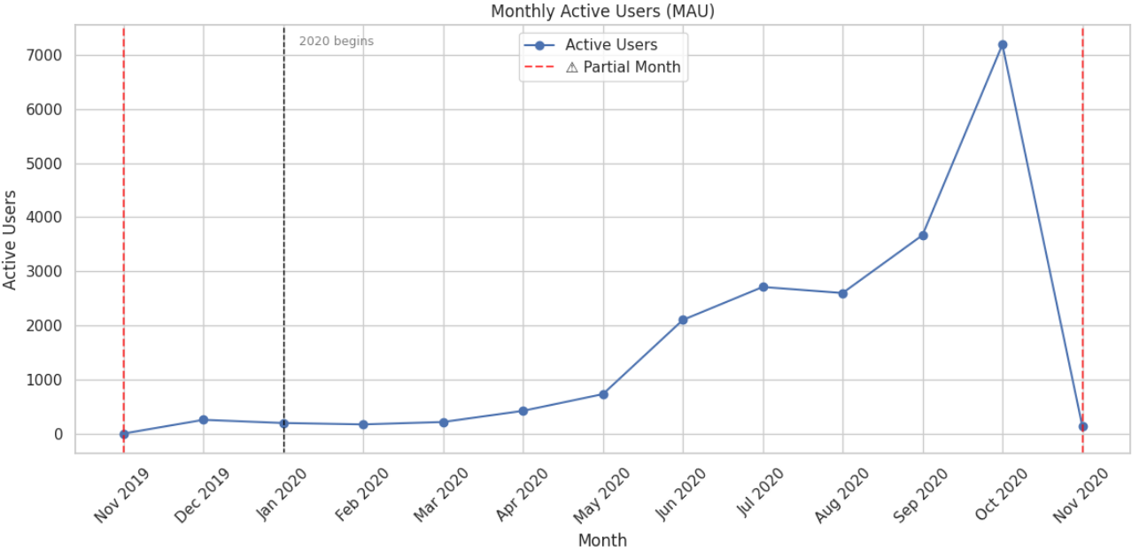
Ready for Cohort Analysis
📆 Cohort Preparation Steps
Extracted first request date per user
Assigned each user a cohort month
Tracked Monthly Active Users (MAU)
Notes:
By merging the datasets, I was able to trace which requests triggered which fees. This linkage is crucial for analyzing user behavior and financial impact at the request level, enabling better cohort-based analysis going forward.

Slide 16
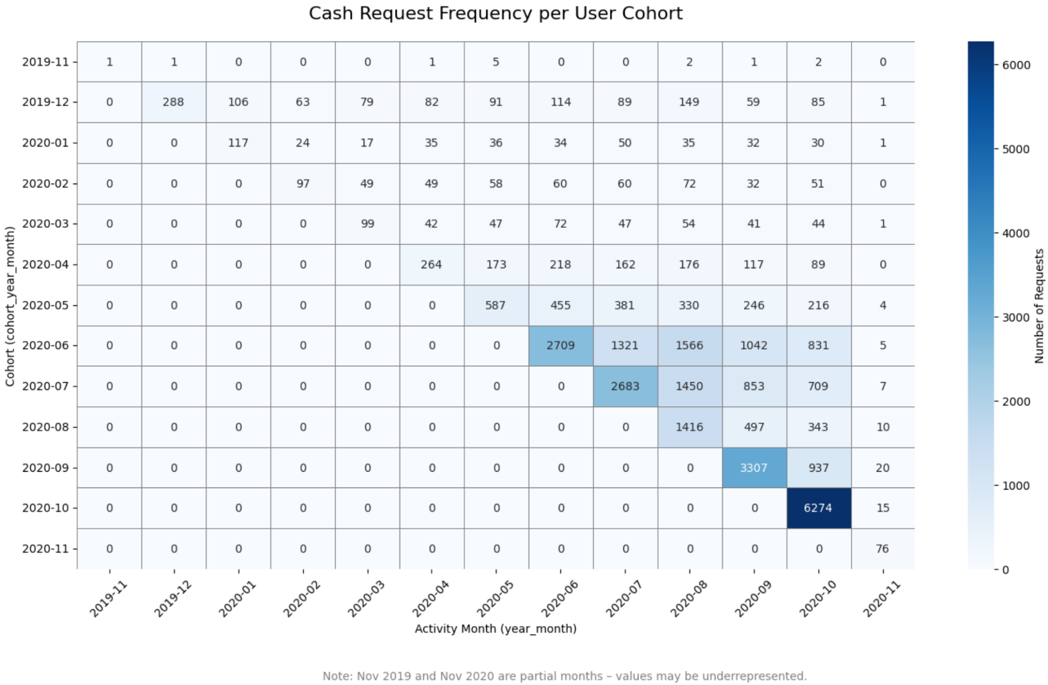
Cohort Usage Frequency
🧮 Cash Request Frequency per Cohort
Platform activity surged starting April 2020, peaking in October 2020 with 6,274.
Other high-activity months include June 2020 (2,709), July 2020 (2,683) and September 2020 (3,307).
Earlier cohorts like Feb-Apr 2020 exhibit sustained multi-month engagement.
Later cohorts (e.g. Aug-Oct 2020) show strong initial use but rapid drop-off, suggesting short-term engagement.
Notes:
This heatmap shows how frequently users from each cohort used the service over time, measured by the number of cash requests per month.
Activity on the platform began rising in April 2020 and peaked in October 2020, which saw over 6,200 cash requests — the highest volume across all months.
We can also see that June, July, and September 2020 were strong months in terms of overall usage.
What's interesting is that earlier cohorts like February to April 2020 show sustained engagement over several months, suggesting better retention.
In contrast, later cohorts like August to October 2020 demonstrate strong initial activity but quicker drop-offs, indicating a more short-term usage pattern.
This pattern highlights a potential shift in user behavior as the platform scaled — something we’ll explore more through retention and CLV metrics in the next steps.

Slide 17
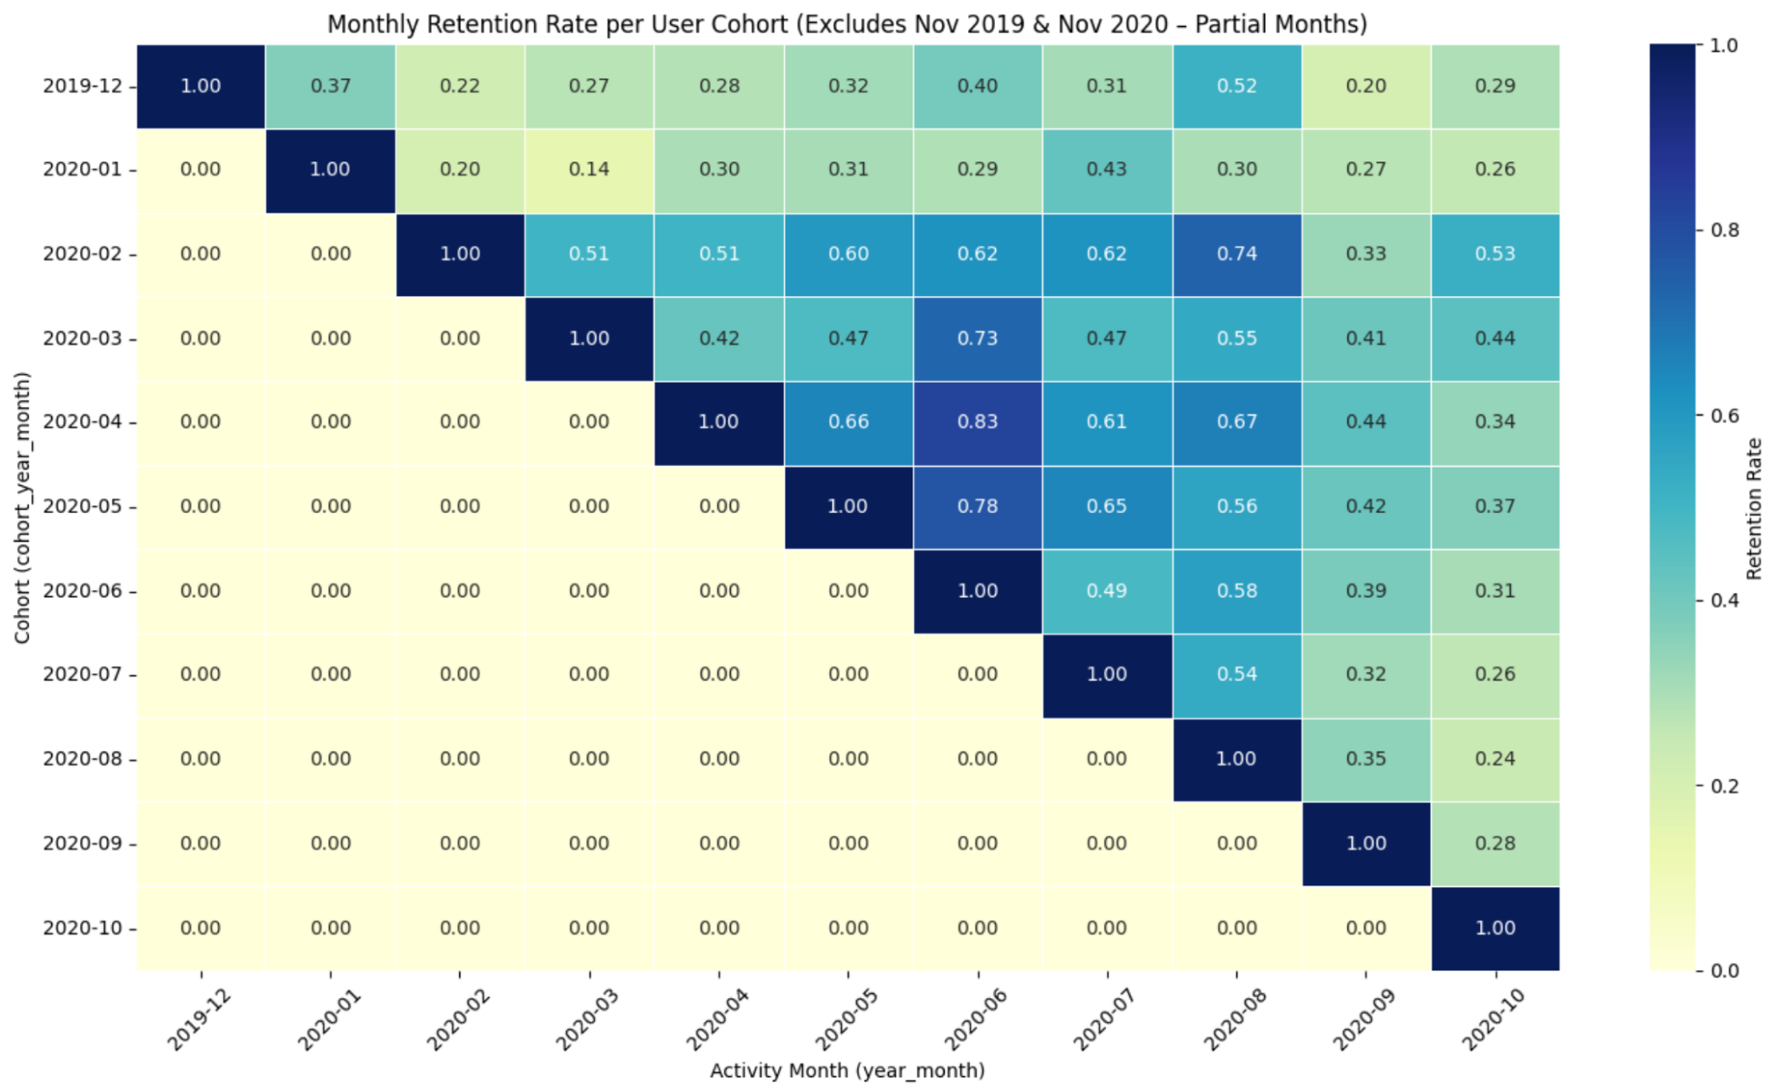
Cohort Retention Trends
🔁 Retention Insights
Retention typically drops after month 1
April 2020 cohort retained 82.6% in month 2 and stayed above 60% through month 4
February 2020 peaked at 74.2% by month 6
Later cohorts showed faster drop-off
Notes:
This filtered heatmap focuses only on complete cohorts and complete months. The April 2020 cohort stands out with exceptionally strong retention — over 82% in month 2 and sustained engagement for several months.
February 2020 also performed well, peaking at around 74% retention by month 6, suggesting effective onboarding or product-market fit during that time.
In contrast, later cohorts show sharper drop-off, highlighting potential areas to improve retention strategies going forward.

Slide 18
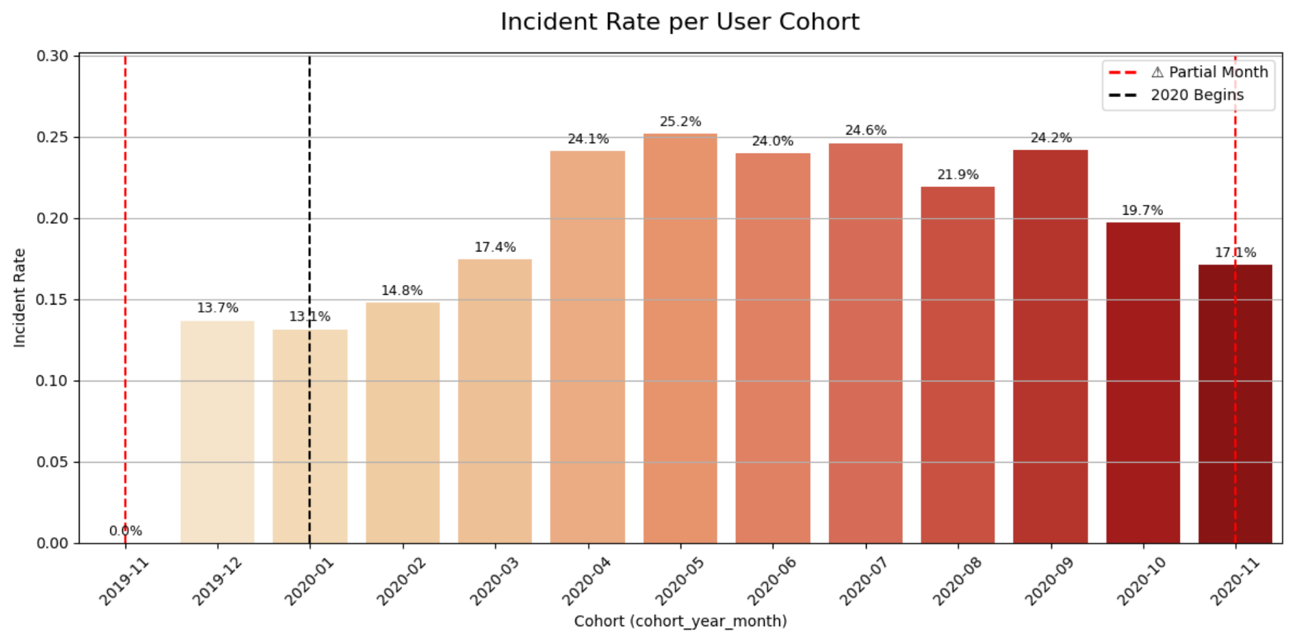
Incident Rates by Cohort
⚠️ Incident Trends
Incident rates peaked around 25% between April-July 2020
Early 2020 cohorts (e.g. Jan-Feb 2020) had lower risk, with rates around 13%
Incident volume closely followed user growth, indicating operational pressure.
Notes:
As platform usage expanded rapidly in mid-2020, incident rates also rose — peaking at over 25% for cohorts between April and July. This likely reflects increased strain on the system from higher request volumes, or onboarding challenges among new users.
Earlier cohorts such as January and February 2020 showed lower incident rates, closer to 13%, suggesting a more controlled environment during those early stages.
These trends help pinpoint when improvements in user education, repayment support, or platform stability would have delivered the greatest impact.

Slide 19
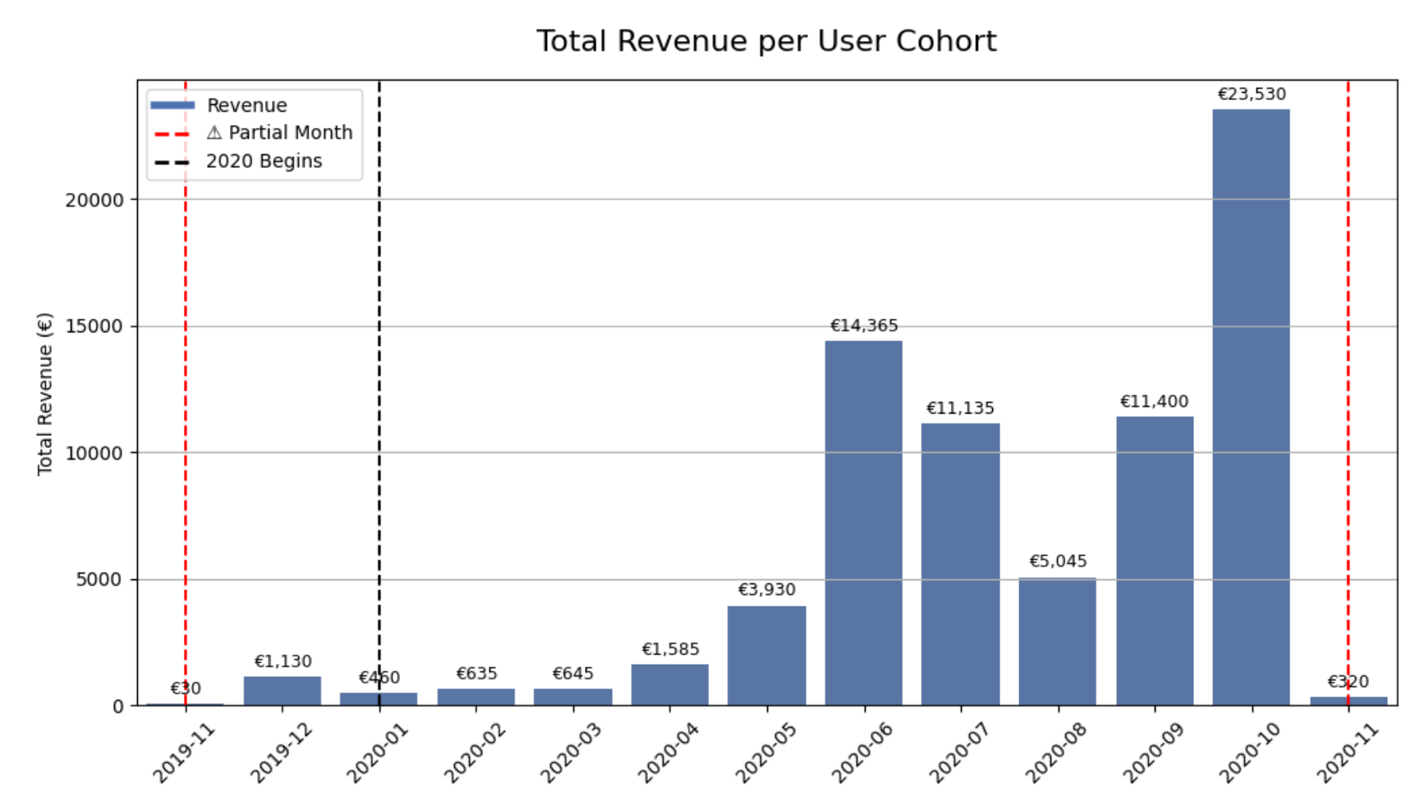
Revenue and Monetization
💰 Revenue by Cohort
October 2020 cohort generated the highest revenue (€23.5k)
June and July 2020 together contributed over €25k
These cohorts also retained up to 49%-54% by the first month, showing stronger early engagement
October 2020 cohort’s retention may be underrepresented due to partial November 2020 data
Notes:
October 2020 was the platform’s top-earning cohort, generating over €23.5k in fees. However, since November 2020 is a partial month, retention for this group may appear lower than it truly was — so we interpret those retention values cautiously.
In contrast, the June and July 2020 cohorts together brought in more than €25k and, importantly, we have follow-up data for these groups. Each retained between 49% and 54% of their users by the first month, signaling stronger early engagement and more reliable insight into user behavior. This makes them valuable benchmarks when evaluating both revenue generation and user retention.

Slide 20
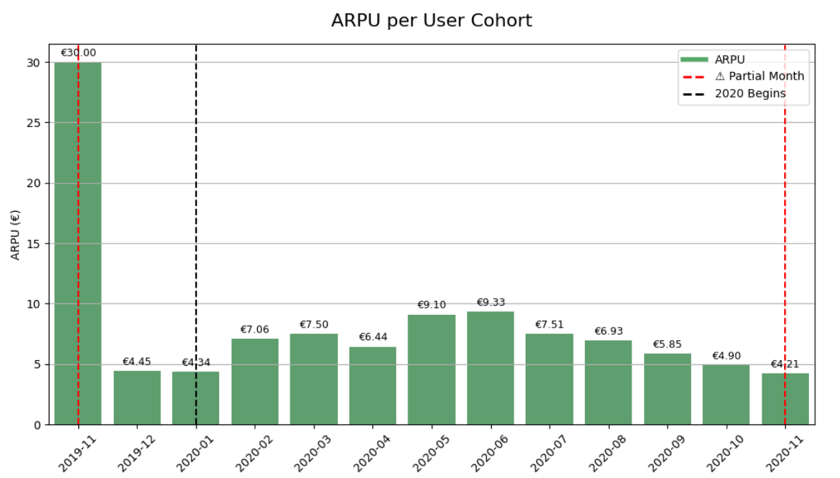
ARPU (Average Revenue Per User) by Cohort
💸 Monetization Effectiveness
June 2020 had the highest ARPU at €9.33
May 2020 and July 2020 also performed strongly (€9.10 and €7.51)
Early cohorts had lower ARPU but smaller user bases
ARPU declined in late 2020 despite user growth
Notes:
This slide focuses on ARPU — how much revenue, on average, each user generated in their cohort. June 2020 stands out as the most monetized cohort with €9.33 per user, followed closely by May and July. These months reflect not only higher user activity, but also more efficient fee collection.
In contrast, early cohorts like December 2019 or January 2020 had lower ARPU, likely due to smaller scale and earlier-stage platform usage. Later cohorts such as October 2020 saw huge user growth but lower ARPU, which may signal monetization challenges when onboarding large volumes quickly.
ARPU helps us understand how well each user was monetized — a valuable lens when compared with retention and lifetime value.

Slide 21
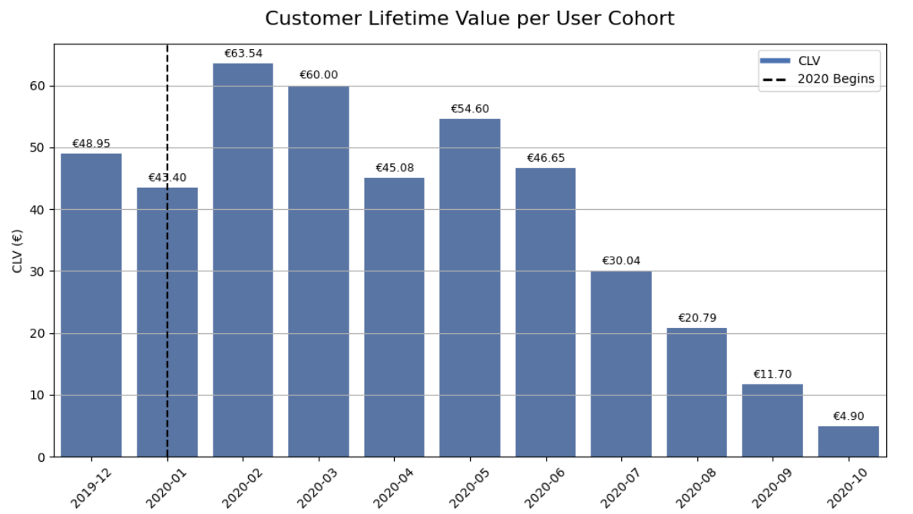
CLV (Customer Lifetime Value) by Cohort
💡 Long-Term Value Insights
February 2020 cohort had the highest CLV at €63.54
March and May 2020 also showed strong CLV (€60.00 and €54.60)
High CLV combines strong ARPU with sustained retention
CLV declines in later cohorts due to faster churn
Notes:
Now we shift from revenue per user to total lifetime value. CLV tells us how much a typical user from each cohort contributed over the course of their engagement.
February 2020 is the clear leader here, with over €63 in lifetime value — not because of volume, but because those users stayed engaged for 9 months on average.
March and May also performed well, pairing strong ARPU with retention. Meanwhile, more recent cohorts had less time to accumulate value and typically showed faster drop-offs in activity.
This metric emphasizes the importance of not just acquiring users, but retaining them. A smaller, loyal cohort can outperform a larger one with quick churn.

Slide 22
Summary of Cohort Analysis
Sharp user growth from April-July 2020, peaking in June
Retention peaks early but was stronger for Feb-May 2020 cohorts
Incident rates rose in May-July 2020, aligned with high activity
June and July 2020 brought in over €25k combined revenue
Feb 2020 had highest CLV (€63.54); June 2020 had the highest ARPU (€9.33)
Notes:
This slide summarizes the most important findings from the cohort analysis. The biggest growth came mid-2020, but only some cohorts retained well. We also saw that the most profitable users weren’t always the newest or largest — loyalty mattered more than size.

Slide 23
Business Recommendations
Prioritize early engagement and onboarding
Improve incident handling during growth surges
Re-engage high-value cohorts (e.g., Feb-May 2020)
Increase ARPU via upsells or loyalty programs
Establish ongoing cohort monitoring
Notes:
Here we translate analysis into action. The goal is to turn insights into retention strategies, better onboarding, and smarter growth. Importantly, we recommend investing in a cohort dashboard to keep tracking these trends continuously.

Slide 24
Thank You!
Questions?
Notes:
Thanks again for reviewing this project. I welcome any questions about the analysis, methodology, or business recommendations.

